Slide 1


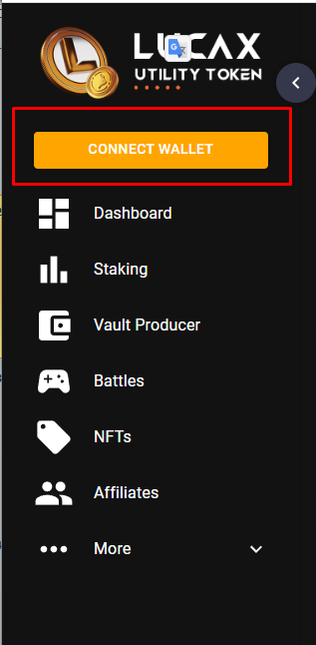

HERE I LEAVE YOU A BANNER AND A SCREENSHOT OF THE TEMPLATE
CHANGE THE WEIGHTING OF 1000 gotEM = 100 Points, meaning 1 zero less
SO YOU CAN HAVE AN IDEA OF THE MODEL COLORS OF THE WEBSITE AND
Image Library https://drive.google.com/drive/u/5/folders/1kkPgq8XZXFZkO7x2-lNUmuODv4lp3QObV
Set a Vault Name

Slide 2


TAKE THE ICON FROM THE DRIVE
https://drive.google.com/drive/u/5/folders/1mfweN1UZopIfyJEqFLzHaqywlwcWbfja
Lucax.cc [EN]
@Lucax_appbot
Keep an eye on the calendar
Every month you'll have chances to win
💰Season 1: $50,000 USD! (November 30th)
💰Season 2: $100,000 USD! (December 31st)
💰Season 3: $150,000 USD! (January 30th)
Next Season Coming Soon
Made by @NoBitcoinNoMoney club

Slide 3

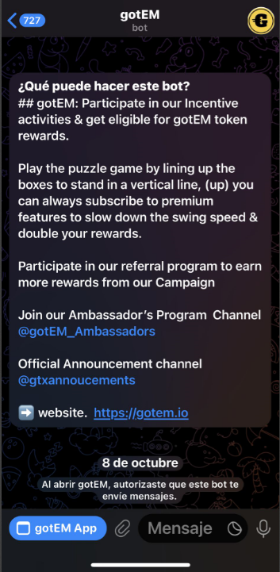
TAKE THE banner FROM THE DRIVE
https://drive.google.com/drive/u/5/folders/1IHn6C-Lg72QJ4ak4_oQwDL7KRE500tst
Hey there! Welcome to $Lucax, The Ultimate Tap-to-Earn Game for airdrops! 🪂
Don’t miss out on amazing $LUCAX Rewards Point! 🎁
Become a top Director of a Skyscraper and dominate the Construction!🏗
💯 Tap the screen, stacking boxes vertically, Building Skyscraper , collect Points and earn frequent rewards and airdrops! 💰
⬆ Upgrade to premium features to slow down the swing speed and boost your score! 🤑.
Other benefits you can get Here:
🧑 Invite Friends: Bring your friends and family for more RPs! More friends = more RPs
🥊 Complete Quests: Finish tasks to rack up even more RPs!
⏰ Act fast before this offer ends!
🎉 Become a part of our exclusive rewards program just for ambassadors. 👉@lucax_Ambassadors 🏅
🌟 website. https://Lucax.cc
Check out our Airdrop Schedule:
💰Season 1: $50,000 USD! (November 30th)
💰Season 2: $100,000 USD! (December 31st)
💰Season 3: $150,000 USD! (January 30th)
Start farming points now, and
Let´s Drive together to the Next MoonShot 🚀
Play2Earn

Slide 4
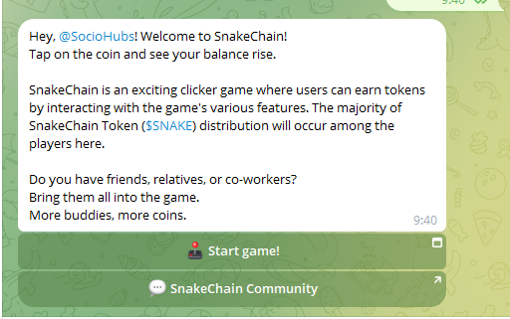

Hey there! Welcome to $Lucax, The Ultimate Tap-to-Earn Game for airdrops! 🪂
Don’t miss out on amazing $LUCAX Rewards Point! 🎁
Become a top Director of a Skyscraper and dominate the Construction!🏗
💯 Tap the screen, stacking boxes vertically, Building Skyscraper , collect Points and earn frequent rewards and airdrops! 💰
⬆ Upgrade to premium features to slow down the swing speed and boost your score! 🤑.
Other benefits you can get Here:
🧑 Invite Friends: Bring your friends and family for more RPs! More friends = more RPs
🥊 Complete Quests: Finish tasks to rack up even more RPs!
⏰ Act fast before this offer ends!
🎉 Become a part of our exclusive rewards program just for ambassadors. 👉@lucax_Ambassadors 🏅
🌟 website. https://Lucax.cc
Check out our Airdrop Schedule:
💰Season 1: $50,000 USD! (November 30th)
💰Season 2: $100,000 USD! (December 31st)
💰Season 3: $150,000 USD! (January 30th)
Start farming points now, and
Let´s Drive together to the Next MoonShot 🚀
Play2Earn

Slide 5
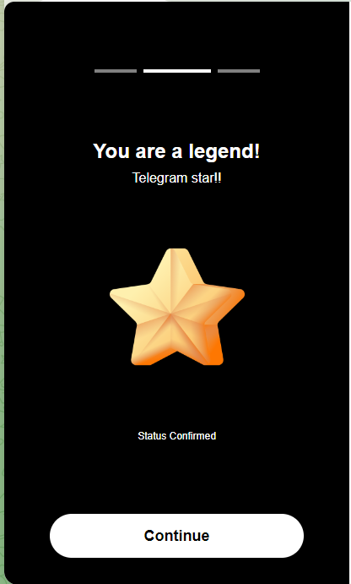
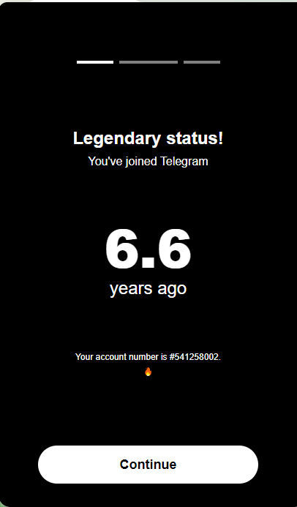

Slide 6
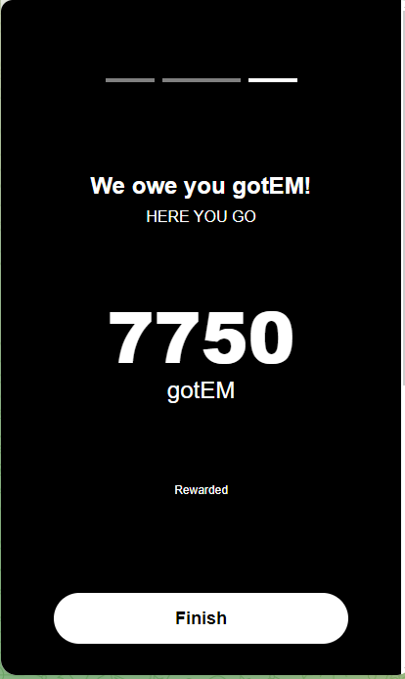


TAKE THE ICON FROM THE DRIVE
Change botton color if you can
https://drive.google.com/drive/u/1/folders/14arQ8b8SWDqBy7i7dJwfZiRIOGN1fUkb
Congratulations!
7750
Point Earned
Come back tomorrow for check-in bonus!
Keep an eye on the calendar
Every month you'll have chances to win
💰Season 1: $50,000 USD! (November 30th)
💰Season 2: $100,000 USD! (December 31st)
💰Season 3: $150,000 USD! (January 30th)
Next Season Coming Soon
⏰ Act fast before this offer ends!
Let´s Drive together to the Next MoonShot 🚀
"Don't waste the Opportunity Again!

Slide 7
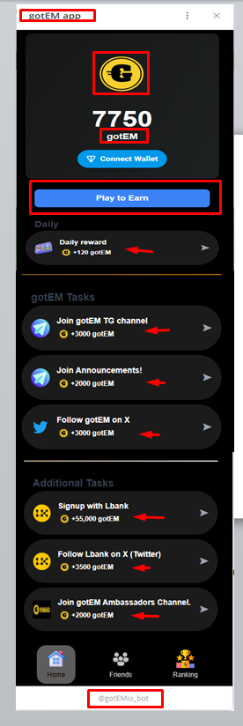
TAKE THE ICON FROM THE DRIVE
https://drive.google.com/drive/u/5/folders/1mfweN1UZopIfyJEqFLzHaqywlwcWbfja
Change botton color
Some task to up loands
2
Daily
Daily reward
+120 Point
Tasks
Join $LUCAX TG channel
+300 gotEM
Join $LUCAX TG Chat!
+2000 Point
Follow $lucax on X
+300 Point
Follow on Medium
+200 Point
Invite 5 friends
+2500 Point
Addicional Tasks
Register On Lucax.cc
+1,500 Point
Join Ambassadors Program:
Clip Master and Commander Chat
+500 Point

Slide 8
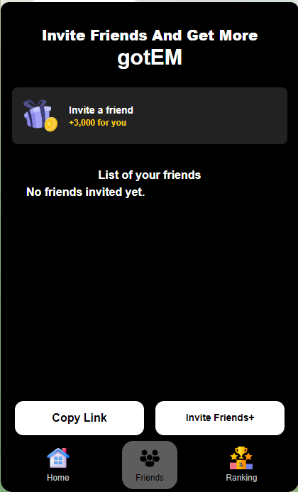
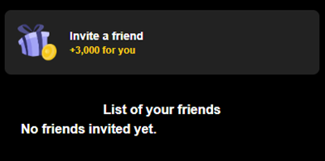


Invite Friends Get Reward Point
More Refer / More Airdrop
How Work
+40 Point For Each
+100,000 Point Pool Share
For the 50 User with more Referral
Copy Link Invite Friends+
Invite friends and earn $MRB. Let's moon! 😎

Slide 9
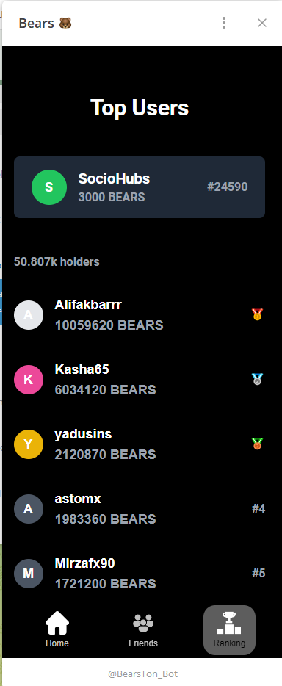


$LUCAX HALL OF FAME

Slide 10
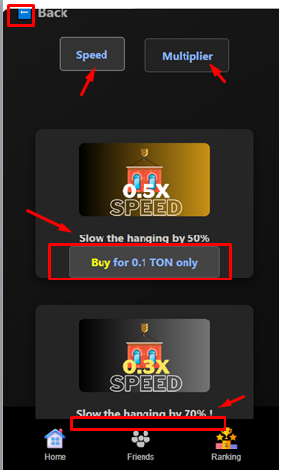
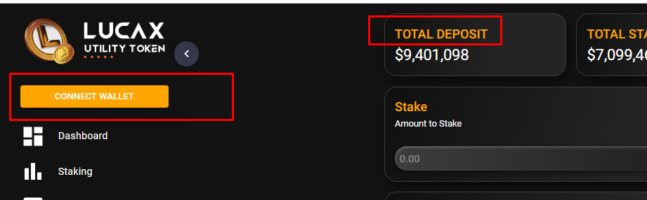
CHANGE BLUE COLOR OF THE LETTERS TO YELLOW COLOR CATERPILLAR AS SAMPLE
CHANGE BOTTON COLOR TO YELLOW CATERPILLAR AS SAMPLE AND PLACE WHITE COLOR LETTERS2

Slide 11
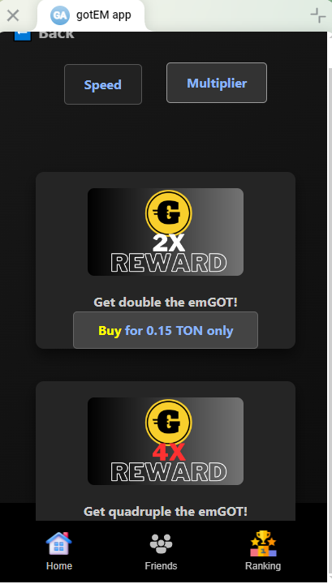
CHANGE BLUE COLOR OF THE LETTERS TO YELLOW COLOR CATERPILLAR AS SAMPLE
CHANGE BOTTON COLOR TO YELLOW CATERPILLAR AS SAMPLE AND PLACE WHITE COLOR LETTERS2
Get double the Reward Points!
Buy for 0.15 TON only
Reward Points!

